Slide 1


Data Warehouse Architecture Comparisons
Michael Pomatto
Data 742

Slide 2
Greater System Control
Greater User Control
Transactional
Systems
Atomic
Layer
The
Data Warehouse
Departmental
Data Marts
Individual
Primitive Data
Updated
Transactional
Day-to-Day Operations
Derived Data
Summarized
Calculated
Inmon’s Four Components
Reference: Inmon Page 16, Figure 1-10

Slide 3
Staging Area
Departmental Data Marts
Main
Transactional
System
Enterprise
Data Warehouse
EDW
Staging
Tables
ETL
Finance
Corporate Applications
Staging
Tables
Sales and Marketing
ETL
External Data
Staging
Tables
ETL
Other Business
Functional Area
Web Data
Staging
Tables
ETL
Decision Support Applications
Business Intelligence
CRM
ERP Reporting
Core Elements of Inmon’s design
Reference: Inmon Page 14 – 24
Operational Data Store

Slide 4
Increasing Business Value
Increased Cost and Complexity
Phase I
Proof of Concept
Phase II
Deploy Data Warehouse
Phase III
Create Departmental Data Marts
Phase N
End State
Six Months
Twelve – Eighteen Months
Multi-Year Effort
Inmon’s Multi-Phased Approach
Reference: Inmon Page 39-41

Slide 5
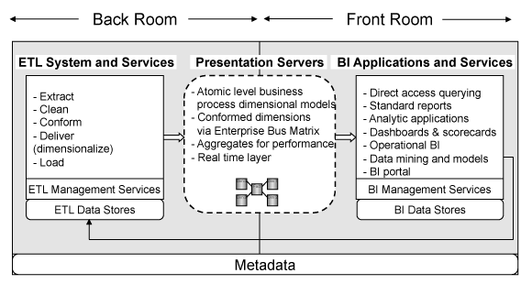
Kimball Architecture
https://www.kimballgroup.com/data-warehouse-business-intelligence-resources/kimball-techniques/technical-dw-bi-system-architecture/

Slide 6
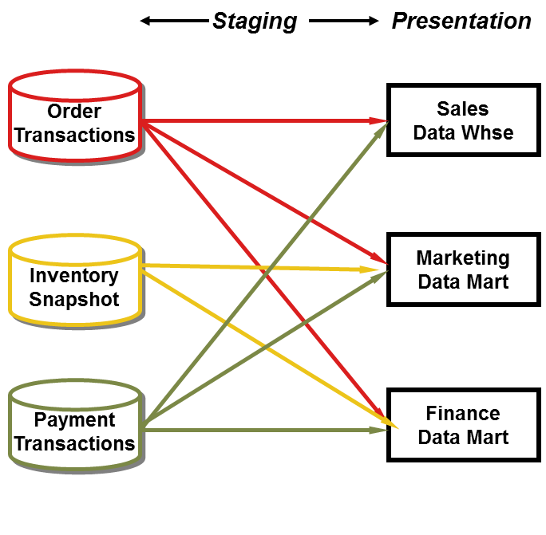
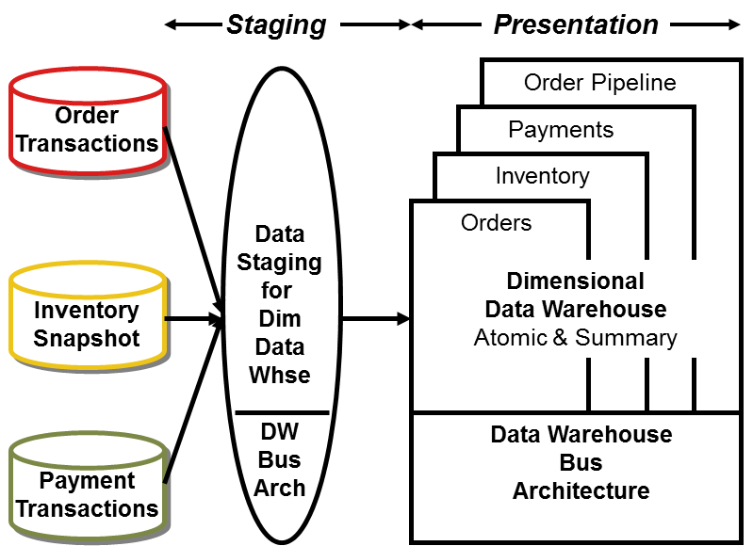
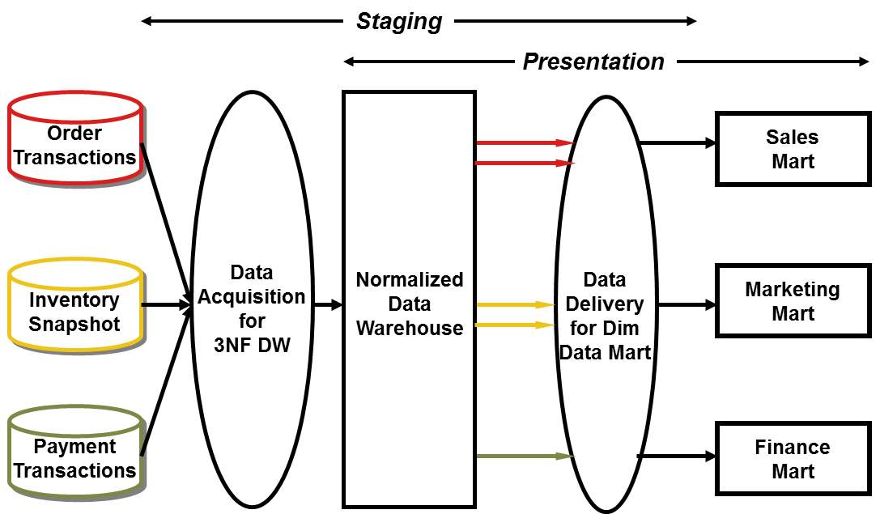
Common in both
Inmon / Kimball Comparison
https://www.kimballgroup.com/2004/03/differences-of-opinion/
Kimball Bus Architecture
Inmon Corporate Information Factory

Slide 7
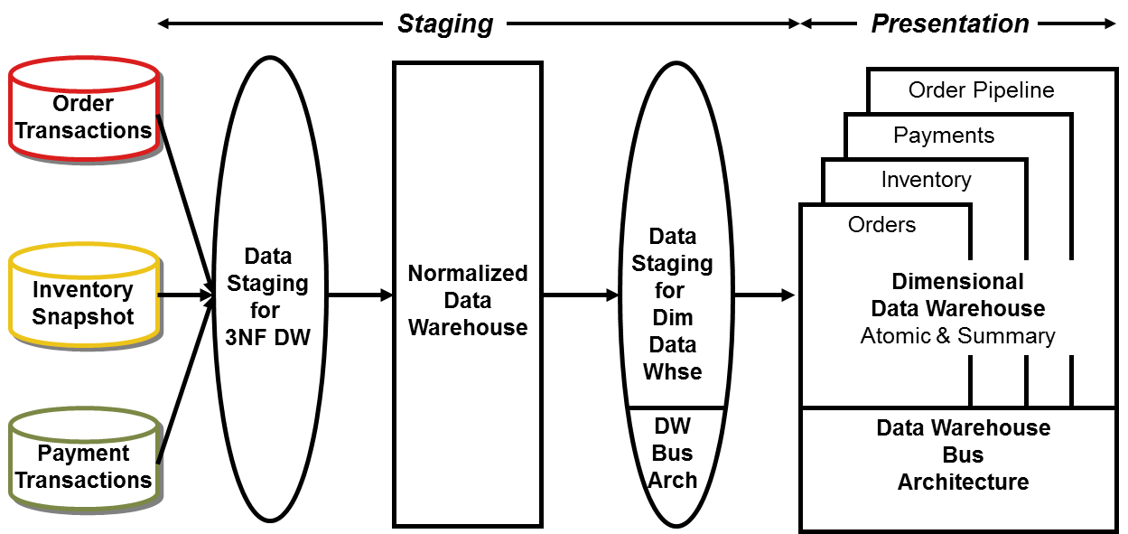
Kimball’s Hybrid
https://www.kimballgroup.com/2004/03/differences-of-opinion/

Slide 8
Lower Granularity
Greater amounts of detail data
Atomic level data
Greater flexibility
Future enhancements
Largest storage requirements
Hybrid
Best of both
Can be table or DW level
Higher Granularity
Summarized or aggregated data
Better for Data Warehousing
Fastest query performance
Lowest storage requirements
Inmon Favors Lower
(Build summarizations in Physical Data marts)
Kimball Favors Hybrid or Higher
(Store Everything dimensionally)
Most Real-World Designs Fall Here
Granularity – The Most Critical Decision
Reference: Inmon Page 41 - 53

Slide 9
Year / Date
Region
Organizational Structure
Data Usage or Type
2015
North West
Retail Stores
Active Warehouse
2016
North East
Online
Archival Data
2017
South
Wholesale
Operational Reporting Data
Date is most common
Business needs often dictate which to use
Multiple strategies can often be used
It will change as the warehouse evolves
Partitioning – Possible Selections
Reference: Inmon Page 53 – 60

Slide 10
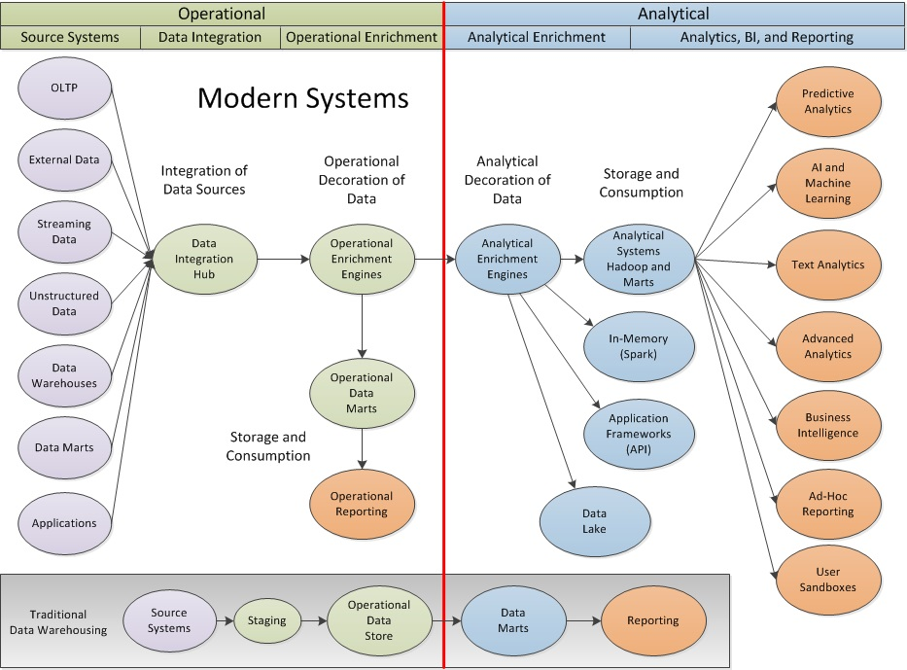
Modern
Hybrids

Slide 11
Four Stages
Value Proposition
Data
All Data
Data Ocean
Data Driven
Decisions
Data Lake
Data for
Future
Needs
Data Pond
Data with
immediate
needs
Better, Faster,
Cheaper
Data Warehousing
Data Puddles
Users
Avoid the Data Swamp!
Gorelik Page 12
High Touch
Self Service
Data Lakes
Reference: Gorelik Page 4

Slide 12
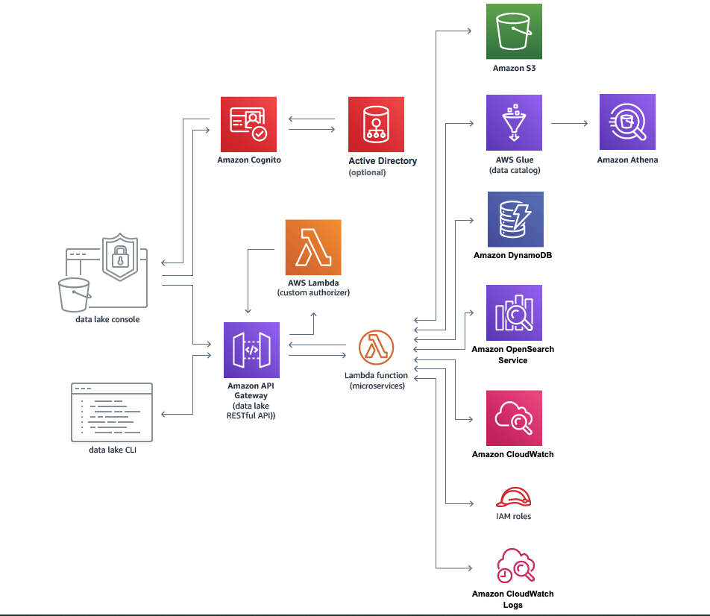
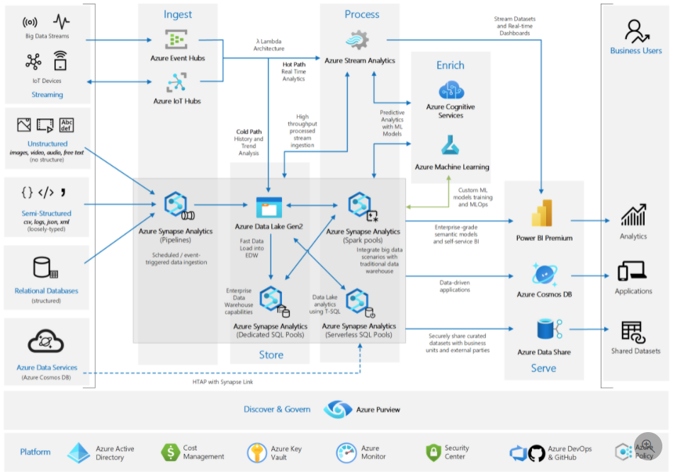
AWS Architecture
Azure Architecture

Slide 13
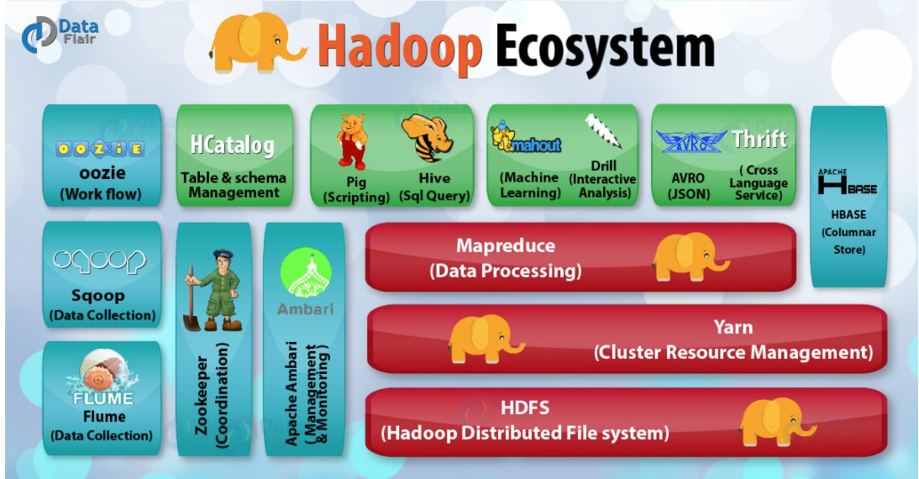
Hadoop Components
Reference: https://data-flair.training/blogs/hadoop-ecosystem-components/

Slide 14
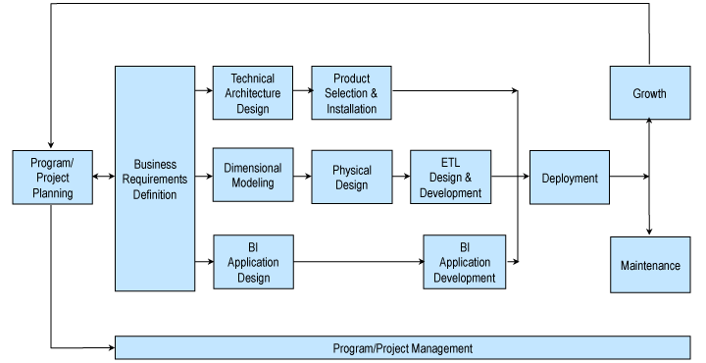
Kimball Lifecycle Methodology
https://www.kimballgroup.com/data-warehouse-business-intelligence-resources/kimball-techniques/dw-bi-lifecycle-method/

Slide 15
Helpful Kimball References
Corporate Information Factory (Inmon) vs. Kimball Bus Architecture
Key aspects of Kimball designs
Warehouse Dining Experience
Design Tips
https://www.kimballgroup.com/2004/03/differences-of-opinion/
https://www.kimballgroup.com/data-warehouse-business-intelligence-resources/kimball-techniques/
https://www.kimballgroup.com/2004/01/data-warehouse-dining-experience/
https://www.kimballgroup.com/2015/11/design-tip-179-key-tenets-of-kimball-method/

